Slide 1

Project of BNN in PULP Platform
组长：11710124 许鹏 组员：11711302 范达熠 11712103 陈诚诺 11713016 肖智骅 11611621 王淼

Slide 2
Outline
Background Review
PULP Environment Build
PULP Platform in FPGA
Network Implementation in PULP
Neural Network System Implementation
Route Summary

Slide 3
1. Background Review

Slide 4
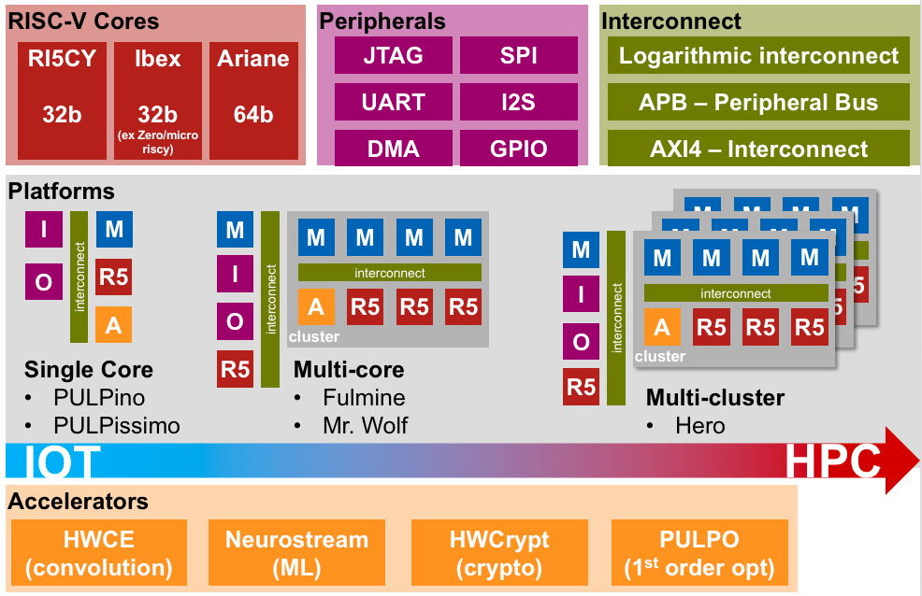
PULP: Parallel Ultra-Low-Power RISC-V Processors
Based on RISC-V ISA: convenient extension & configurable module
ETHZ:
1) Open source MCU SoC platform
2) Different RISC-V processor cores
3) PULP-NN multicore library

Slide 5
QNN: Quantized Neural Network
Real-valued weight and activation values n-bit fix-point number
Favor the deployment of CNN models into resource constrained devices
INT-N data type
Specific retraining procedures
1) the accuracy drop is very low (0.3% for ResNet50 in INT-2 )
2) energy efficiency gain is orders of magnitude higher

Slide 6
PULP-NN Library
The first multicore computing library for Quantized Neural Network (QNN) inference on fully programmable edge devices
Support low bit-width (8-bit, 4-bit, 2-bit and 1-bit) operations
An open-source optimized library based on the CMSIS-NN dataflow:
1) A full set of kernels
2) Many utilities to support QNN

Slide 7
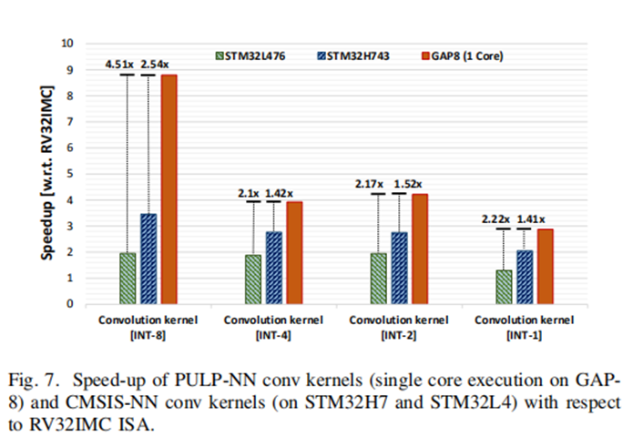
SIMD Instructions Extension
Processing more sub-word data in parallel:
accelerate dot product & lower power consume
The best data type supported by the ISA with the SIMD extensions is INT-8

Slide 8
2. PULP Environment Build

Slide 9
RISC-V GNU Compiler Toolchain
1. Getting the sources
$ git clone --recursive https://github.com/pulp-platform/pulp-riscv-gnu-toolchain
2. Prerequisites
$ sudo apt-get install autoconf automake autotools-dev curl libmpc-dev libmpfr-dev libgmp-dev gawk build-essential bison flex texinfo gperf libtool patchutils bc zlib1g-dev
3. Build the Newlib cross-compiler for pulp
export PULP_RISCV_GCC_TOOLCHAIN = /opt/riscv
export PATH=$PATH:$PULP_RISCV_GCC_TOOLCHAIN/bin
./configure --prefix=/opt/riscv --with-arch=rv32imc --with-cmodel=medlow --enable-multilib
make

Slide 10
PLUP SDK Build
1. Prerequisites
$ sudo apt install git python3-pip python-pip gawk texinfo libgmp-dev libmpfr-dev libmpc-dev swig3.0 libjpeg-dev lsb-core doxygen python-sphinx sox graphicsmagick-libmagick-dev-compat libsdl2-dev libswitch-perl libftdi1-dev cmake scons libsndfile1-dev
$ sudo pip3 install artifactory twisted prettytable sqlalchemy pyelftools openpyxl xlsxwriter pyyaml numpy configparser pyvcd
$ sudo pip2 install configparser
$ git clone --recursive https://github.com/pulp-platform/pulp-riscv-gnu-toolchain
2. Get the sources and make
$ git clone https://github.com/pulp-platform/pulp-sdk.git -b 2019.04.05
$ cd ./pulp-sdk
$ source ./configs/gap.sh
$ make all
$ make env
$ source ./sourceme.sh

Slide 11
PULP Platform Build
1. Get the sources
$ git clone --recursive https://github.com/pulp-platform/pulp
Then you need to install the Modelsim to make the sim platform
2. Building the RTL simulation platform
$ ./update-ips
$ ./generate-scripts
$ source setup/vsim.sh
$ cd sim/
$ make clean lib build opt

Slide 12
PULP-NN Library Build
1. Get the sources
$ git clone https://github.com/pulp-platform/pulp-nn
2. Set the environment and make it
$ export PULP_SDK_HOME=<absolute path to the pulp-sdk folder>
Then make a Makefile with the contents below
PULP_APP = Main //The name of your application
PULP_APP_FC_SRCS = cifar10_main.c //The name of your main function
PULP_APP_CL_OMP_SRCS = pulp_nn_cifar10.c //The name of the file use the pulp-nn library
PULP_APP_CL_OMP_SRCS += $(wildcard ./../../kernels/*.c) //The path of the function’s kernels
//use the below parameters directly
ifeq ($(prof),1)
PULP_CFLAGS = -DPROFILING
Endif
ifeq ($(check),1)
PULP_CFLAGS += -DCHECKLAYER
endif
PULP_CFLAGS += -DNUM_CORES=8 -O3 -Iinc -w
PULP_LDFLAGS = -lm
include $(PULP_SDK_HOME)/install/rules/pulp_rt.mk

Slide 13
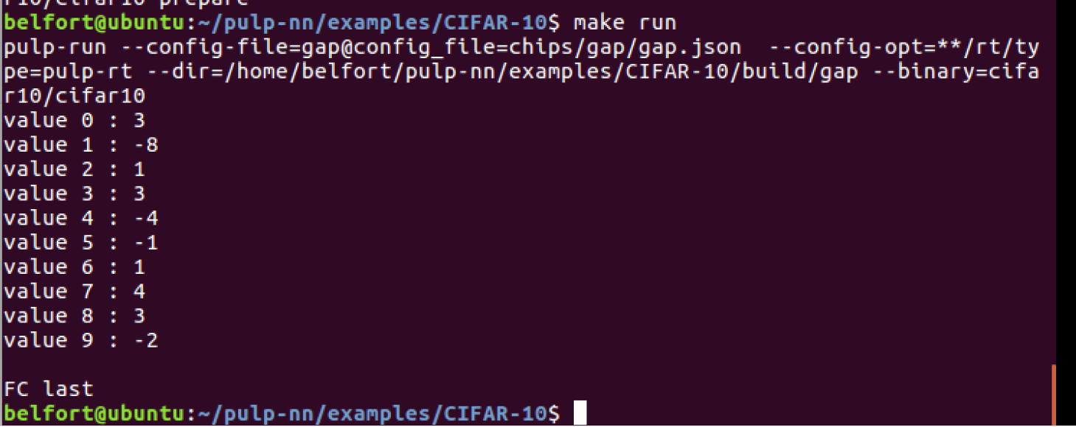
Preliminary Test
Input: a image
Output: the category information
Notes:
PULP platform: 低精度
Tensorflow： 高精度然后量化

Slide 14
3. PULP Platform in FPGA

Slide 15
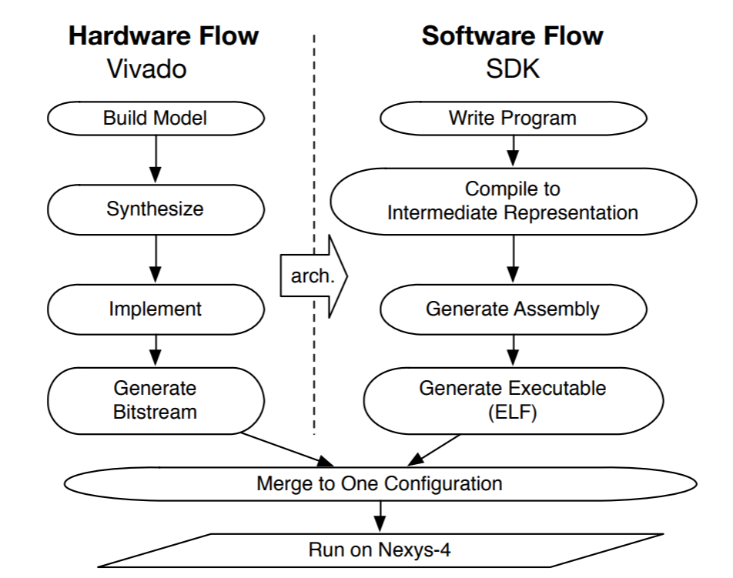
The FPGA Implementation of PULP
PULP-NN’s implementation in Vivado SDK
Notes:
PULP platform: 低精度
Tensorflow： 高精度然后量化

Slide 16
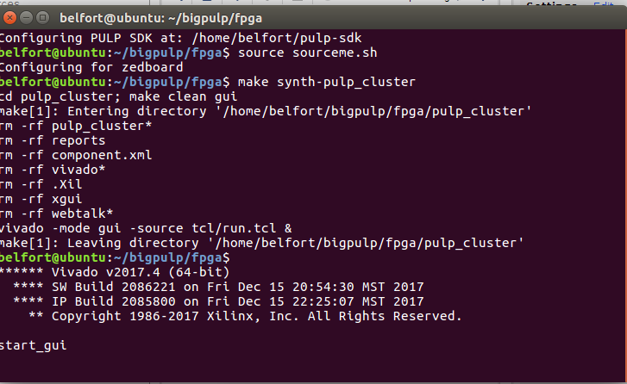
Notes:
按照教程，我们开启vivado

Slide 17
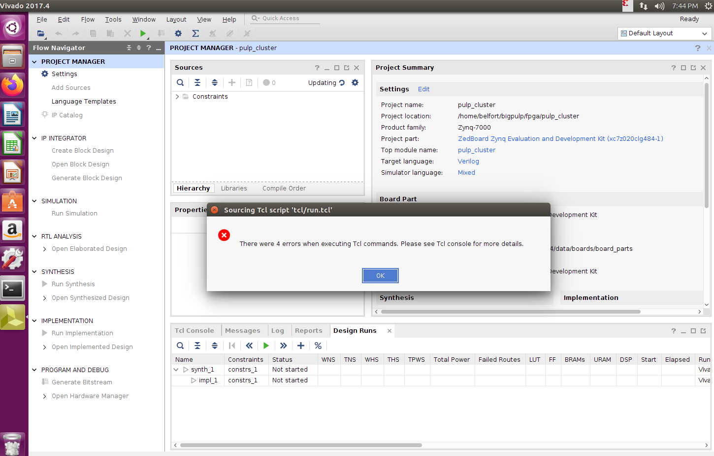
Notes:
打开vivado后，软件在执行TCL命令时会报这样的错误

Slide 18
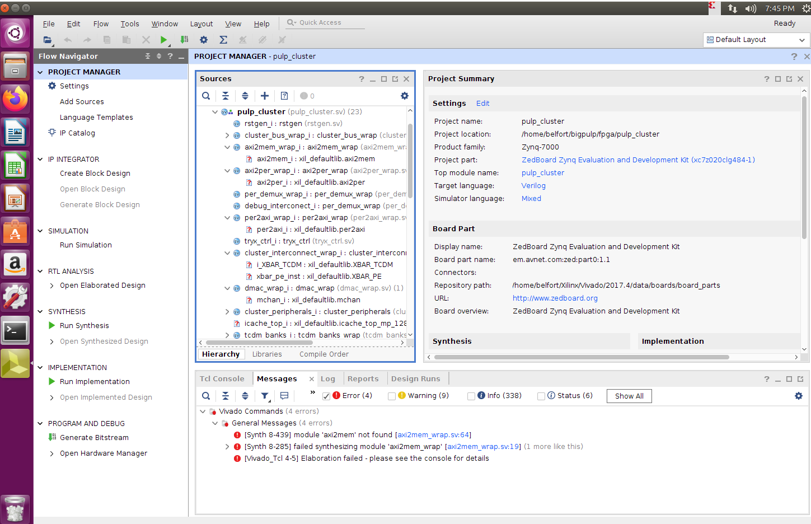
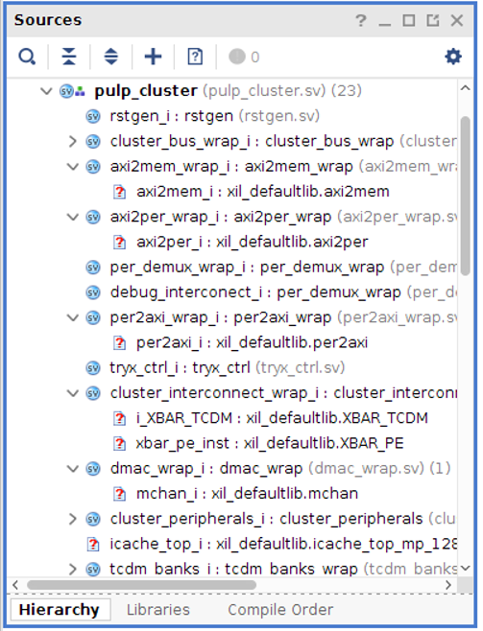
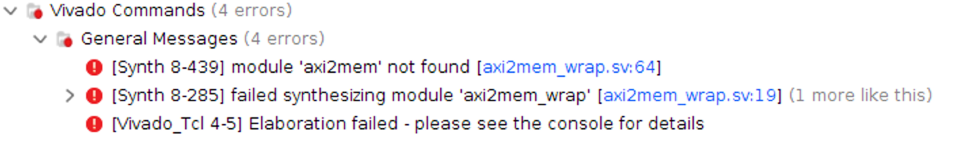

Notes:
仔细看我们会发现里面有非常多模块缺失，例如缺失axi2mem_wrap中的axi2mem模块

Slide 19


Notes:
因此我们到pulp-platform的github项目网站上找到了axi2mem
这个是axi2per模块

Slide 20


Notes:
但是在github上有一些模块是找不到的，比如XBAR_TCMD模块，没有XBAR_PE

Slide 21
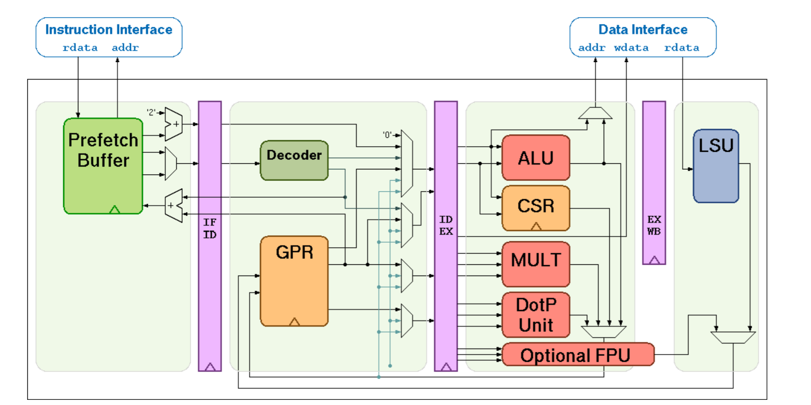
RI5CY Architecture

Slide 22
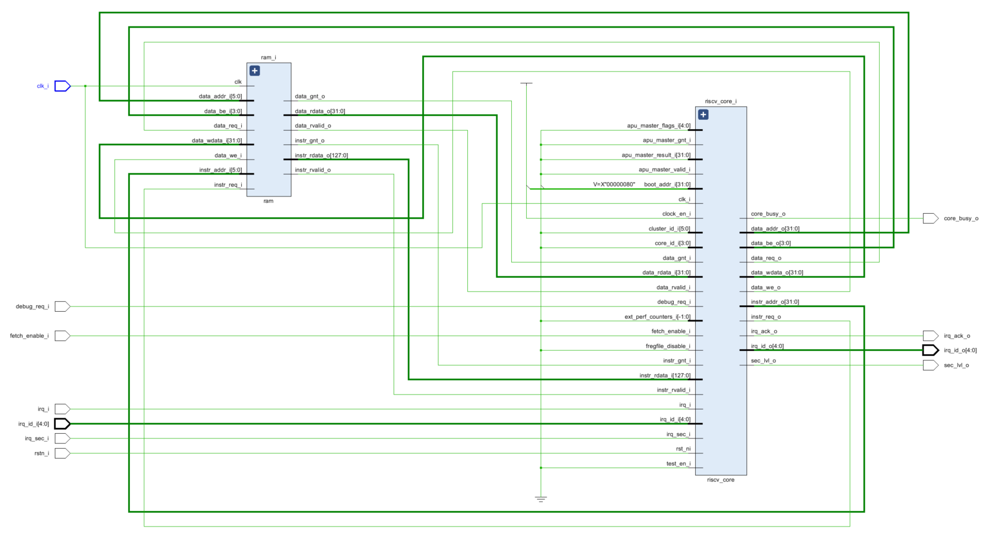

Slide 23
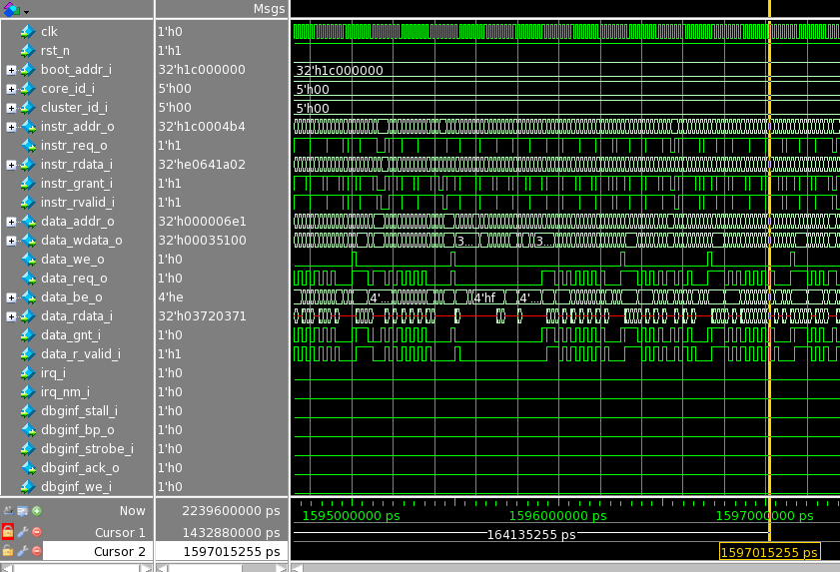
PULP Core Simulation in Vivado

Slide 24
4. Network Implementation in PULP

Slide 25
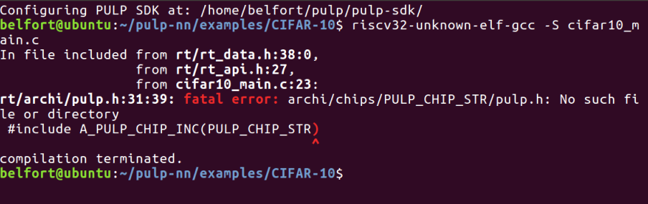
Notes:
我们在前面跑出样例的是通过make命令执行的，make命令运行了写好的makefile文件。我们希望通过pulp平台的riscv32-gcc将c文件编译出s文件和o文件，但是当我们直接调用gcc编译时会不断地报错误，错误提示我们在路径中没有找到rt的文件，然后我们找到rt文件把它复制到运行目录中，解决了出现的问题又会报新的错误。因为rt_xx.h文件是一层套一层的。

Slide 26
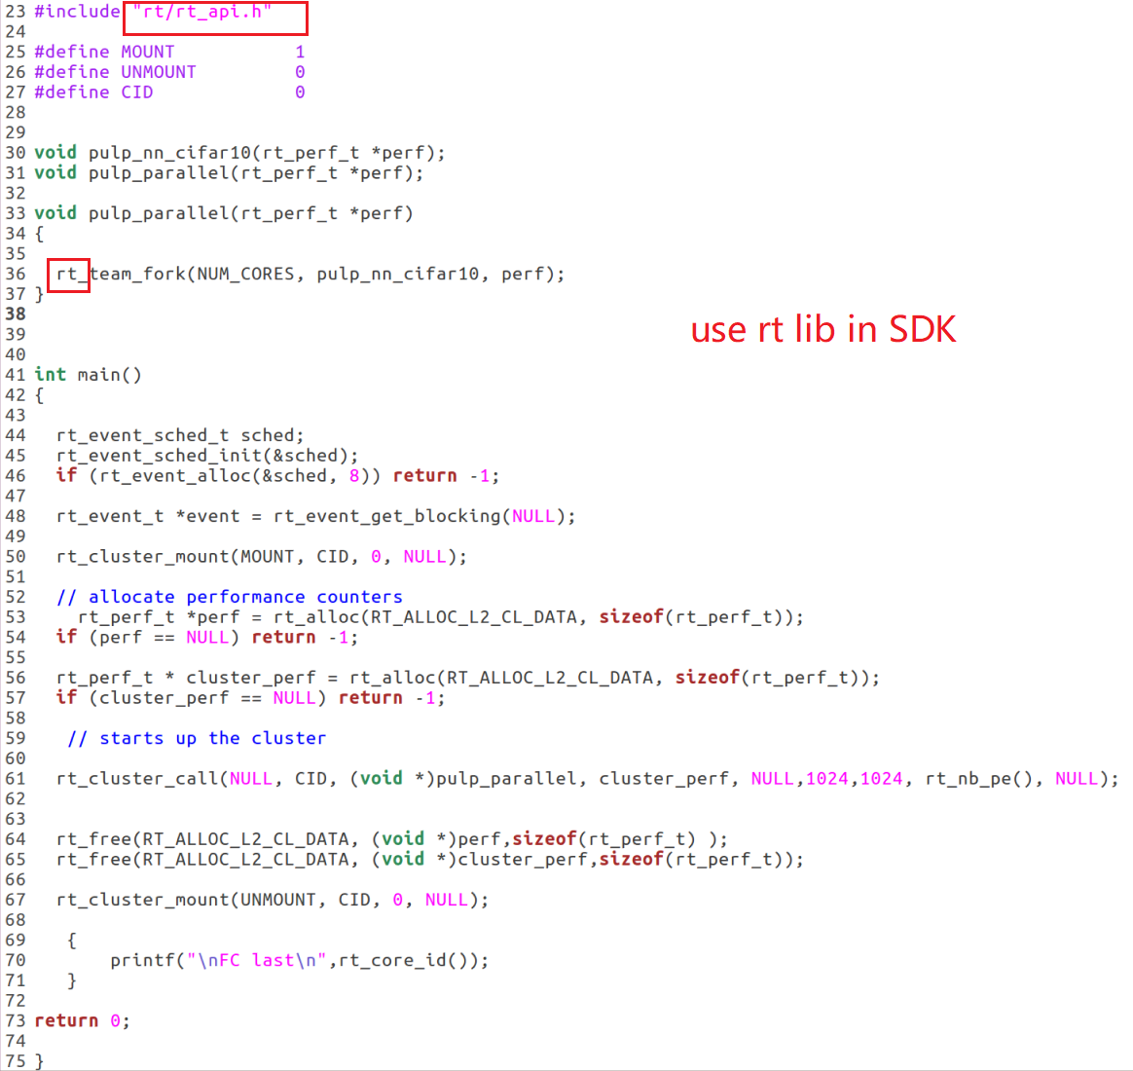
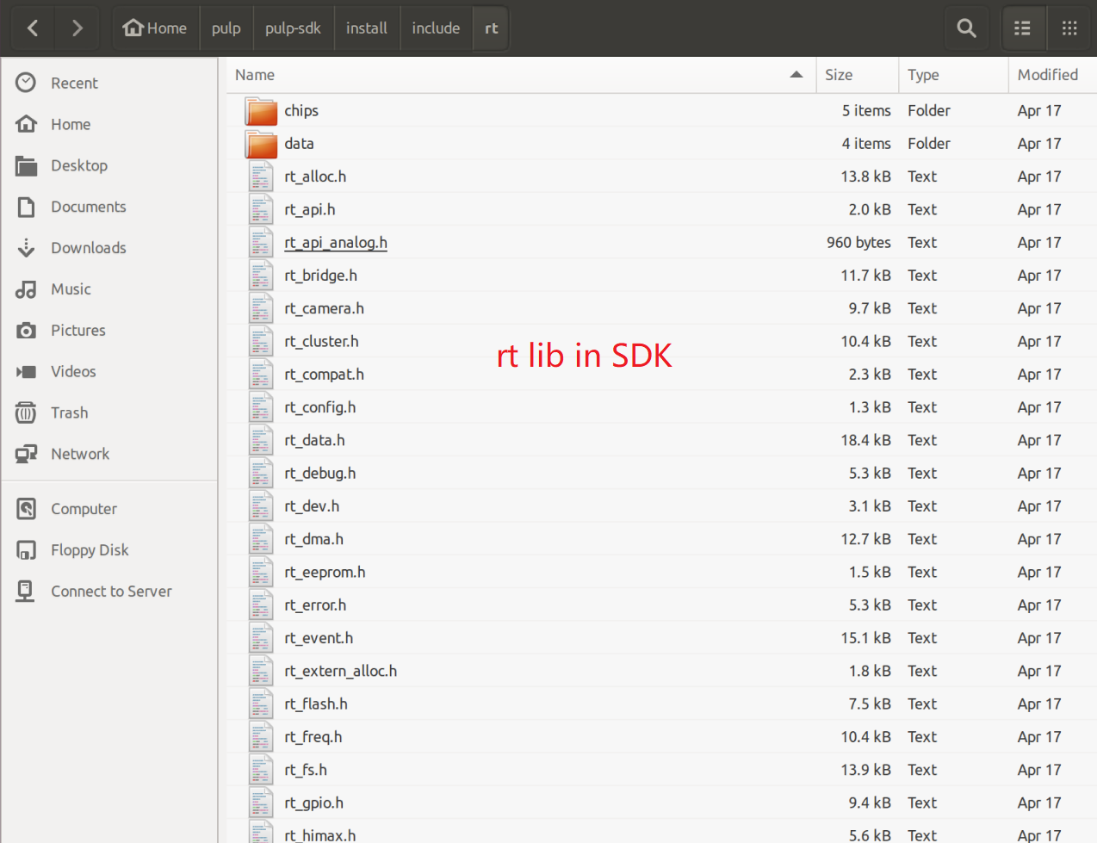

Slide 27
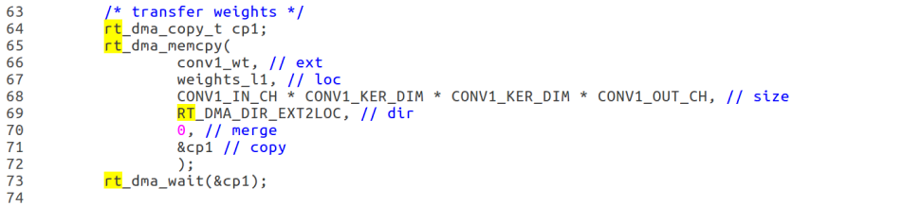
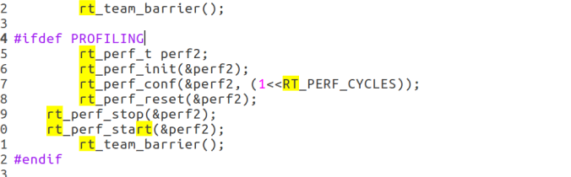
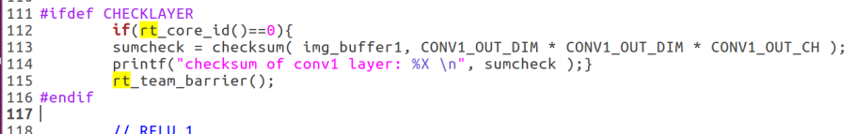
rt
Memory
Profiling
Check
Notes:
在重新看给的cifar10例子的代码，我们观察到这代码调用的主要是sdk的rt库。我们找到rt的目录 看了里面写的内容，发现这里用到了rt的三个功能，第一个是memory， 第二个是profiling，第三个是check。Memory是用来传输数据的，profiling是用来性能评估的，而check是用来检测神经网络层是不是正常。Profiling和check是可以删掉的，我们只要自己将数据写到memory里就可以完成rt做的工作。

Slide 28
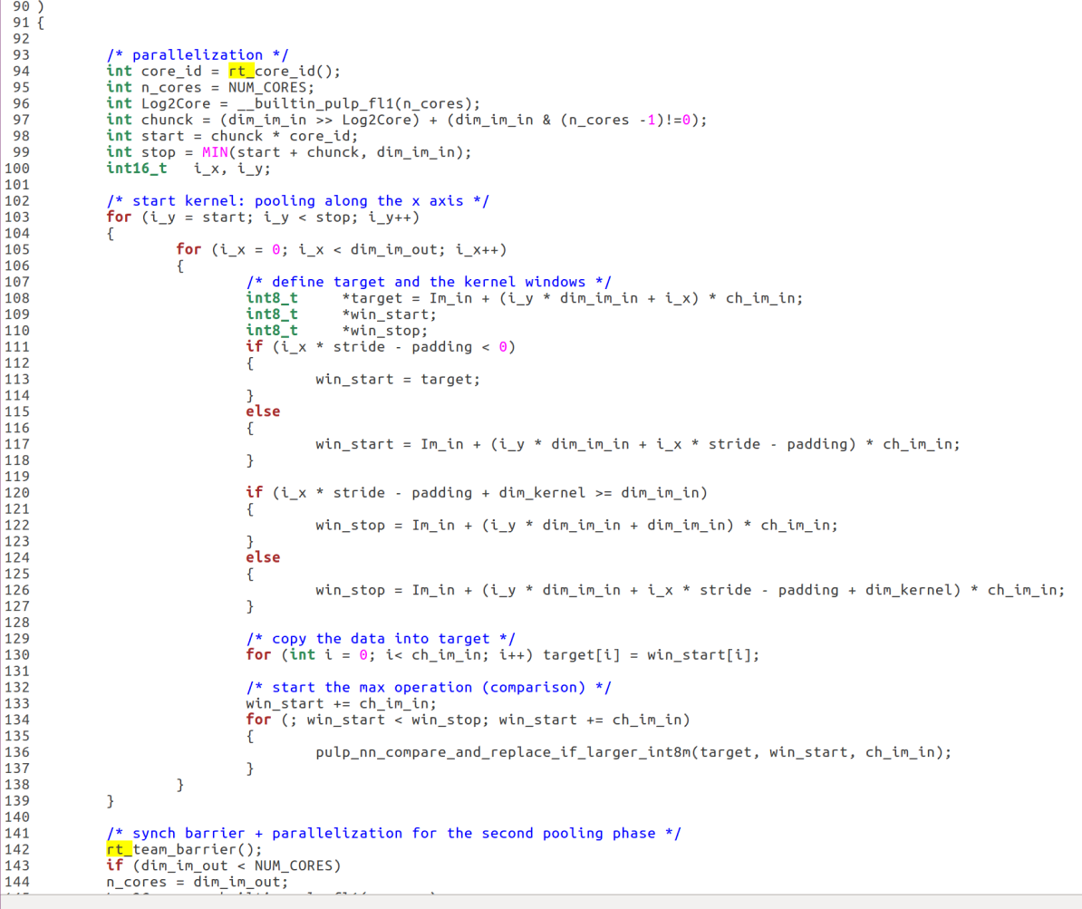
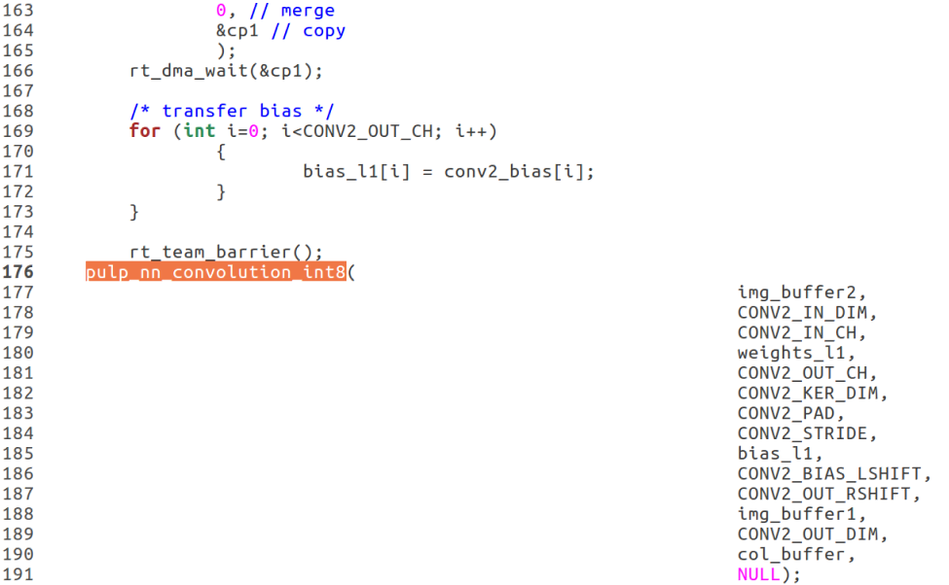


rt_core_id()
rt_team_barrier()
Notes:
这个是kernal中实现神经网络的核心函数。在这个函数中我们找到两个和rt相关的内容，一个是rt_core_id() 一个是rt_team_barrier。这两段代码都是与多核有关的，前者是多核分配的一个功能，这里我们只需要把核写死就可以，后者起到一个协调核与核之间工作的一个作用，删去即可。

Slide 29
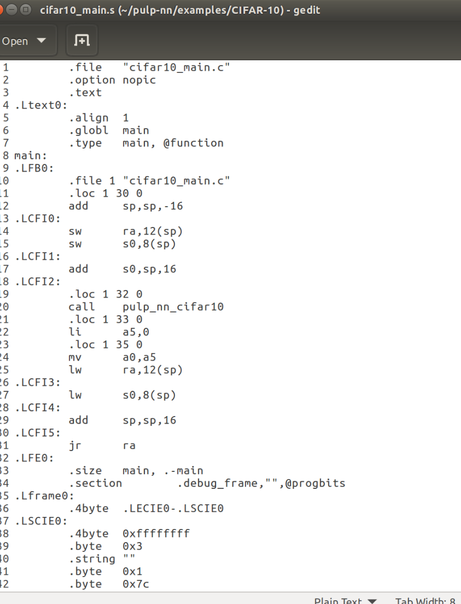
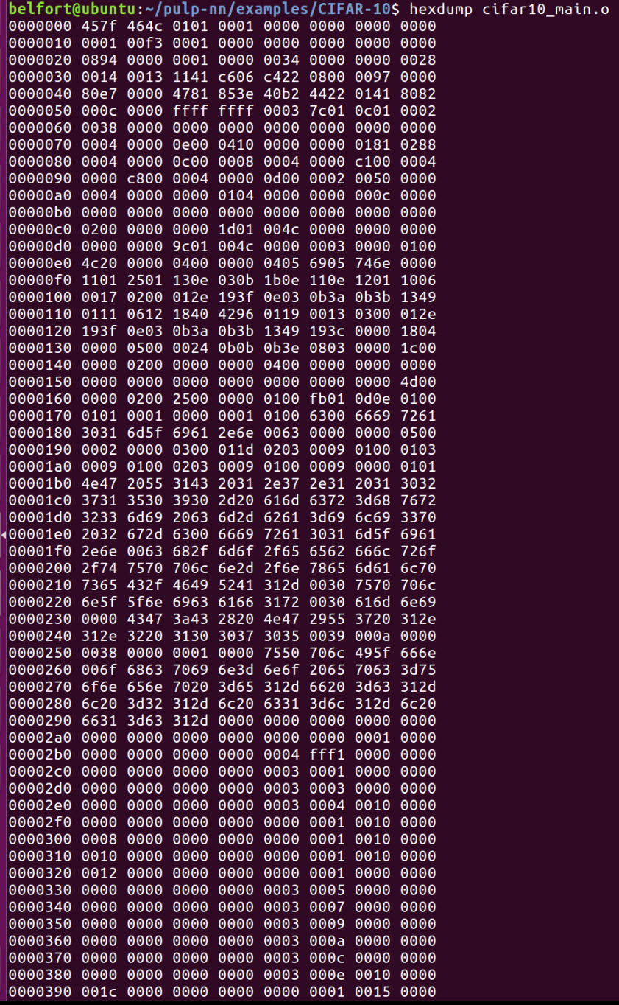
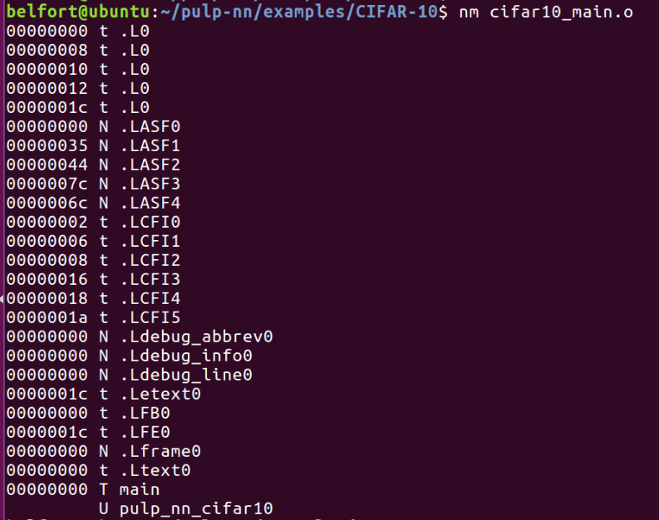


.o file
.s file
Notes:
左边的图中我们能看出，在做完前面的修改之后，我们可以成功得编译出主程序cifar10_main得汇编代码。.s文件
进一步我们可以得到cifar10.o文件 机器码文件。这里我们可以看到每一个分支函数对应的地址位置
中间是是主程序机器码文件的
第二张图是这样的，我们在生成.s文件之后 .s文件里有很多label
这些用于标记的label在.o文件里也存在 label不一定用于跳转

Slide 30
Neural Network System Implementation
Overview & Parameters Import
OV5640 Camera
VGA to HDMI Output
CNN Interface
CNN Simulation Results
Route Summary

Slide 31
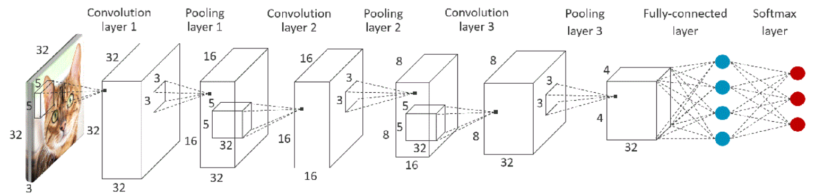
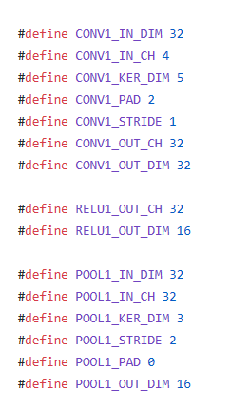
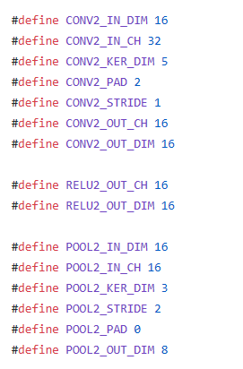
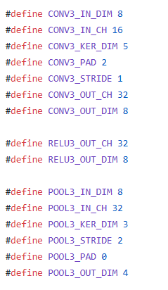
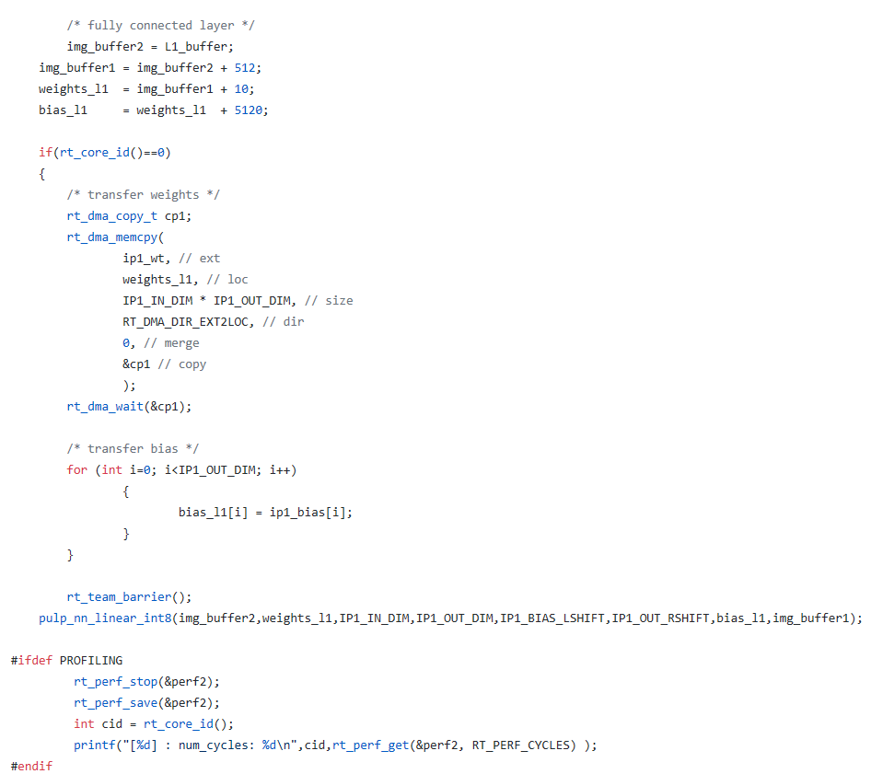
Pulp-nn archetecture
It contains 3 hiden layers
Total:input+3 hiden +1 fully+ output=6
Notes:
首先我们尝试继续走bigpulp的那条技术路线
我们之所有又考虑了bigpulp是因为big pulp有完整的开源架构
回应余浩问这个综合超资源的问题，之前我们在综合的时候出现问题的原因是我们没有注意在设置的时候只用了fpga片上的SRAM，只用SRAM是不够用的，但是加上片外的ram资源是够用的。

Slide 32
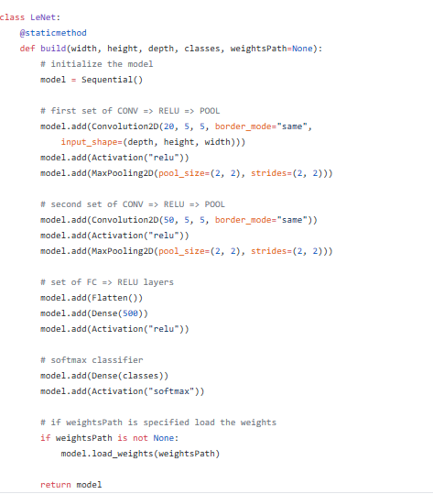
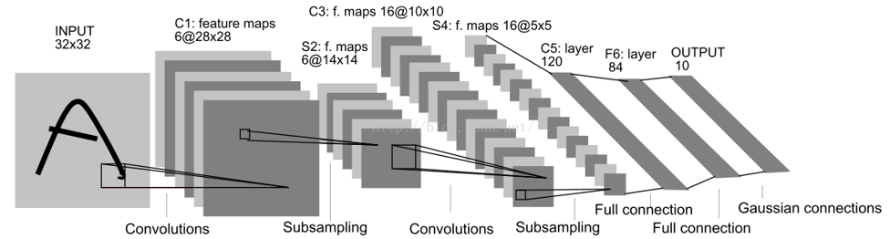
LeNet-5 archetecture
It contains 2 hiden layers
Total:input+2 hiden +3 fully=6
Notes:
首先我们尝试继续走bigpulp的那条技术路线
我们之所有又考虑了bigpulp是因为big pulp有完整的开源架构
回应余浩问这个综合超资源的问题，之前我们在综合的时候出现问题的原因是我们没有注意在设置的时候只用了fpga片上的SRAM，只用SRAM是不够用的，但是加上片外的ram资源是够用的。

Slide 33
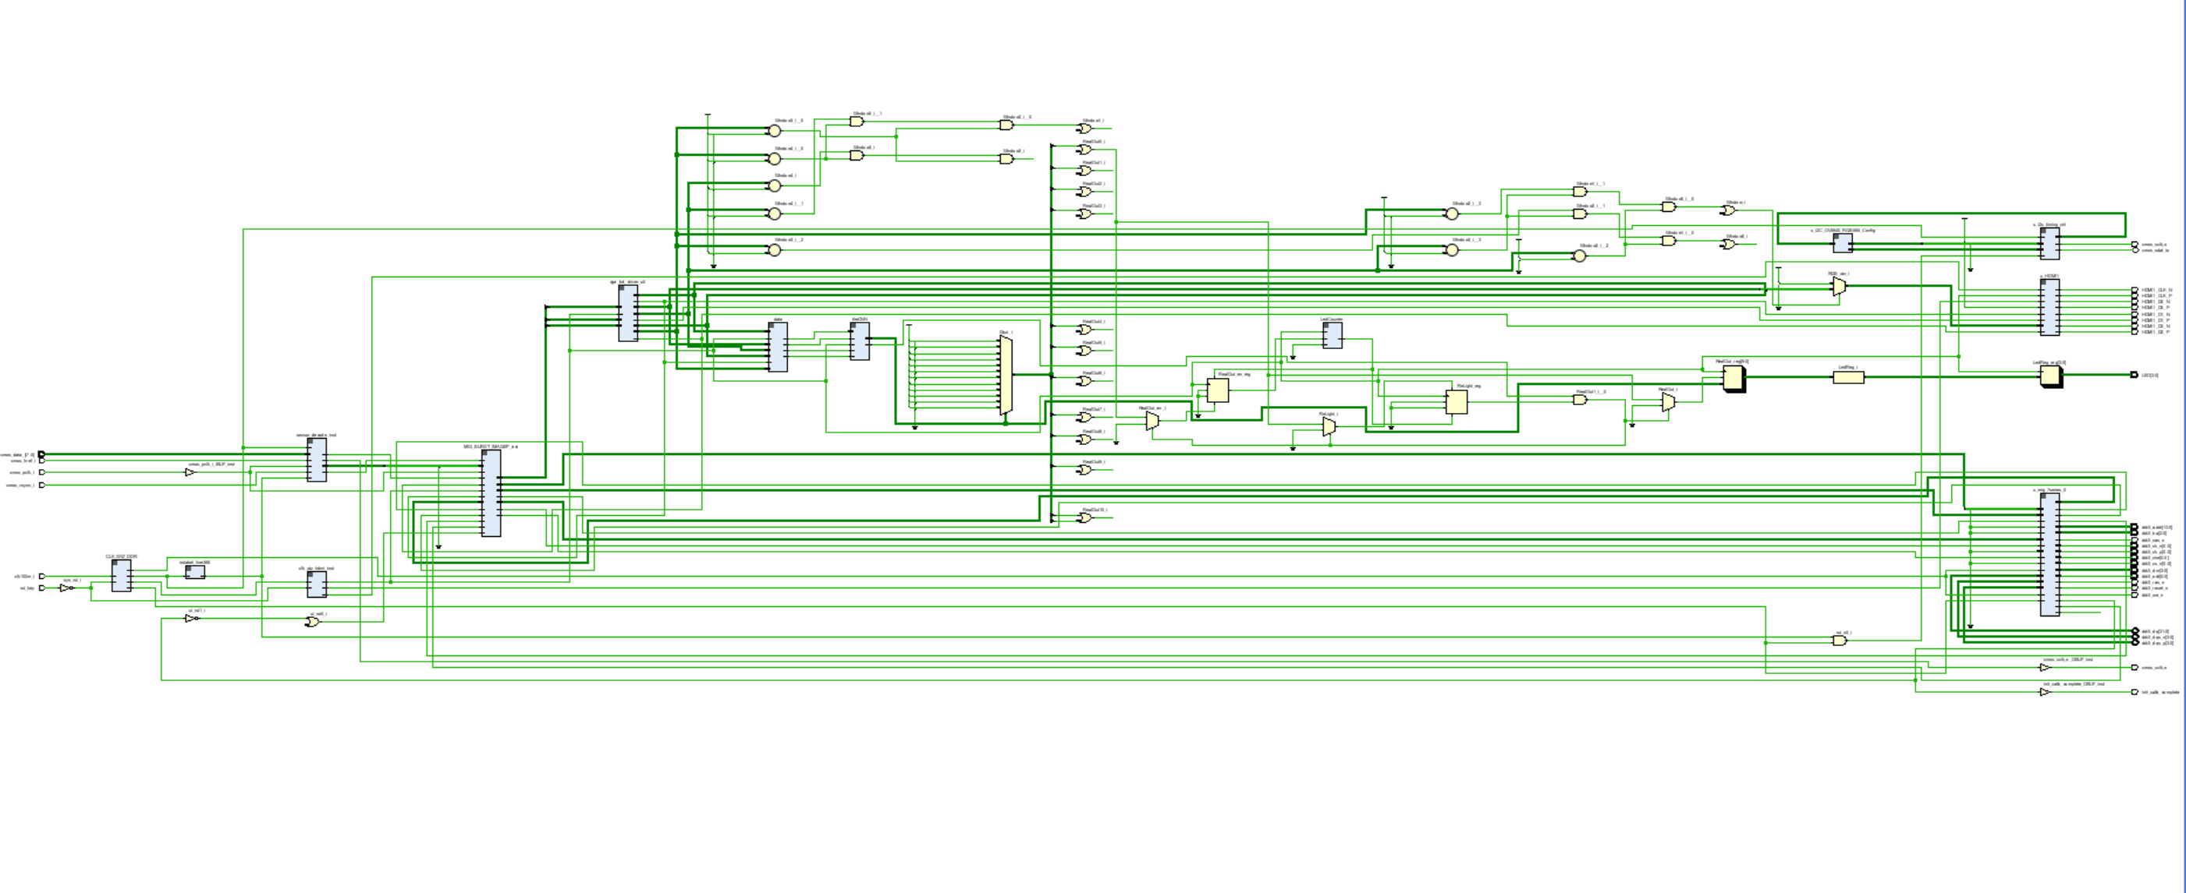
Overview
Based on RISC-V ISA: convenient extension & configurable module
ETHZ:
1) Open source MCU SoC platform
2) Different RISC-V processor cores
3) PULP-NN multicore library

Slide 34
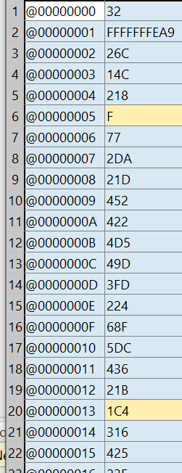
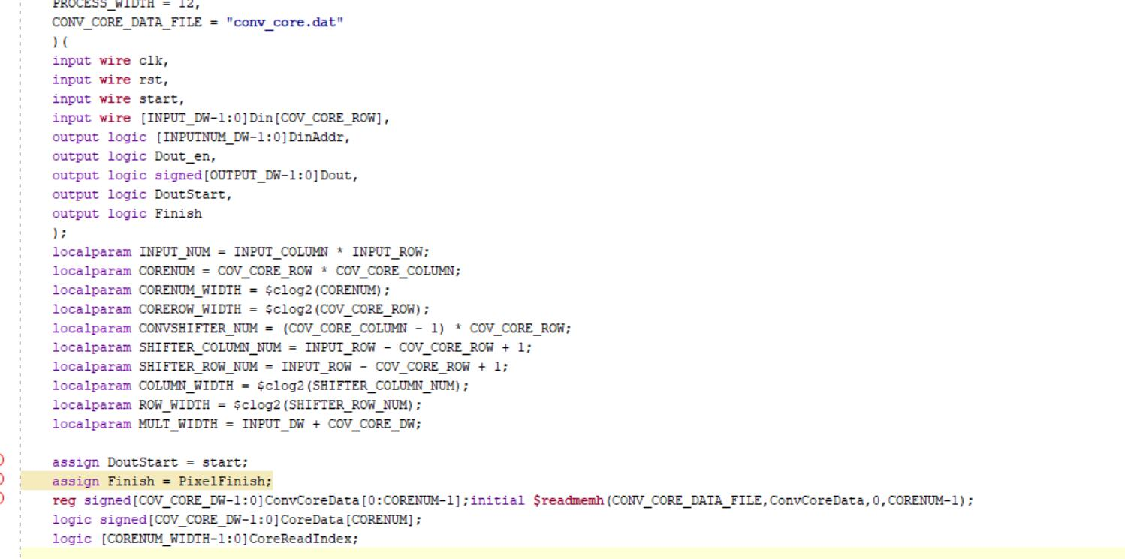
Parameters Import
Based on RISC-V ISA: convenient extension & configurable module
ETHZ:
1) Open source MCU SoC platform
2) Different RISC-V processor cores
3) PULP-NN multicore library

Slide 35
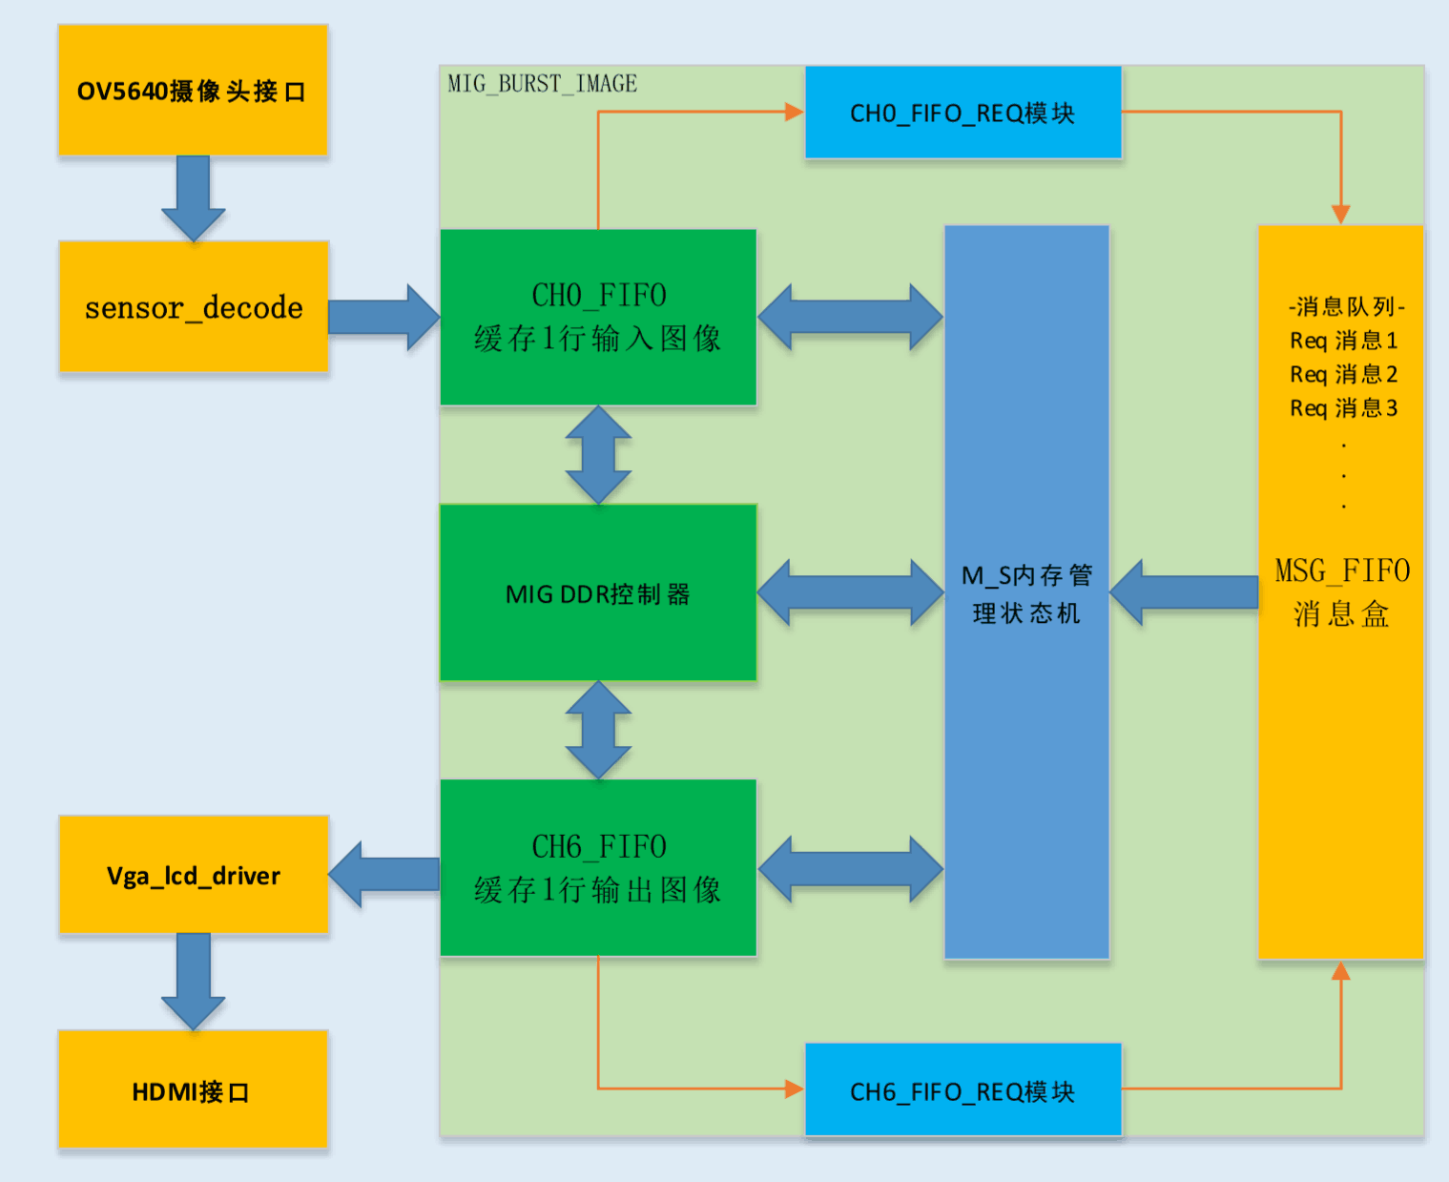
OV5640 Camera
Imaging sensor catch pixels
Save pixels in FIFO (use MIG DDR to store)
Generate RGB signal
Extract effective RGB signal

Slide 36
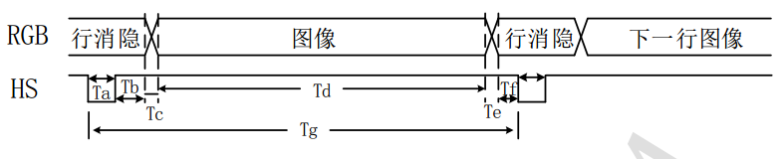
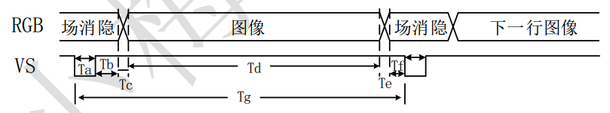
VGA to HDMI Output: 1280*720 @60 Hz
VGA signal:
H_sync
V_sync
VGA_de
VGA_r
VGA_g
VGA_b

Slide 37
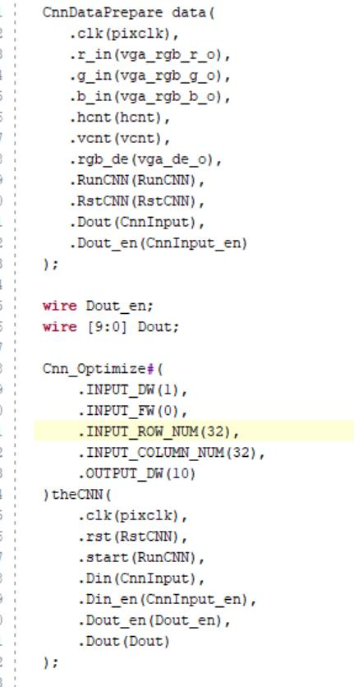
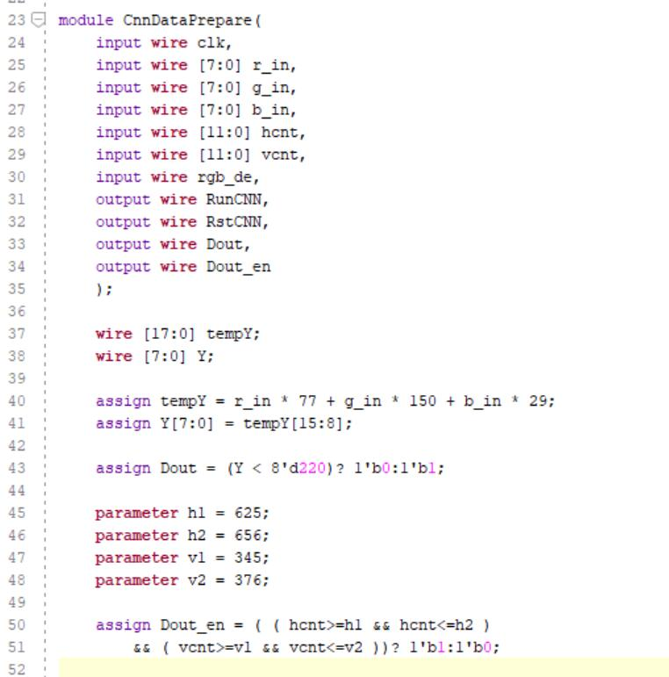
CNN Interface
Rectangle image (32×32)
Binary image (1024)
Import to CNN (1024)

Slide 38

CNN Interface
Expanded pixel selection field (64×64) Rectangle image (32×32)

Slide 39
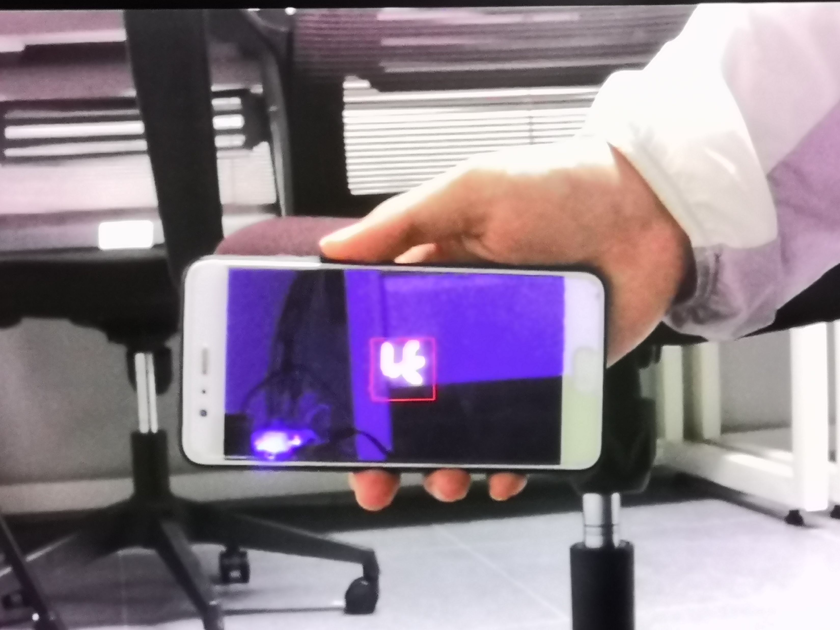
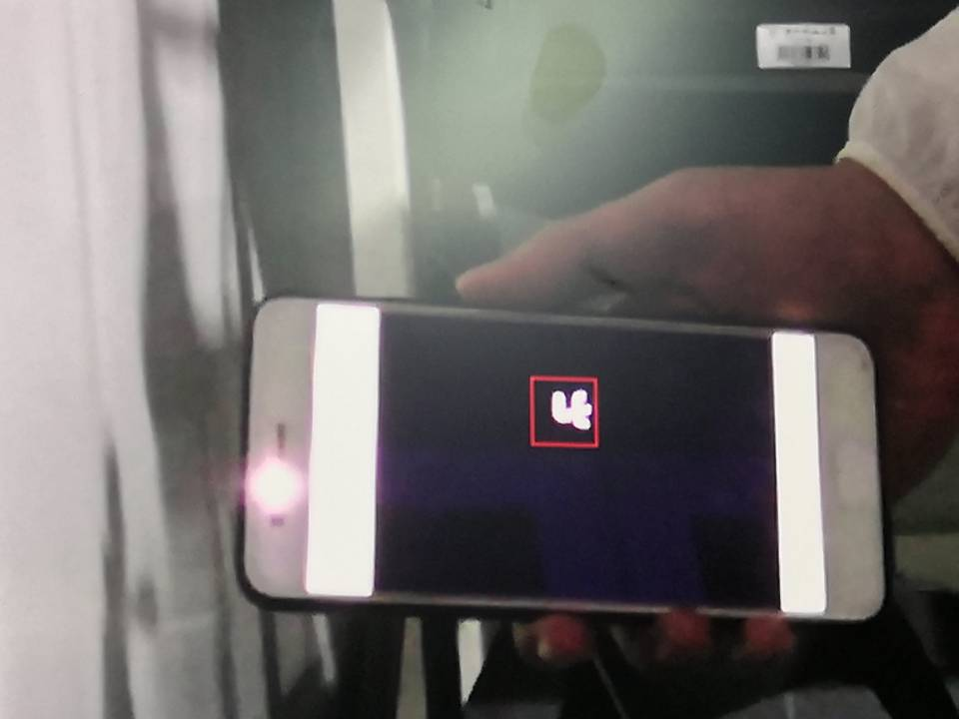
CNN Interface

Slide 40
CNN Simulation Results
0-9 Digitals: waveform

Slide 41
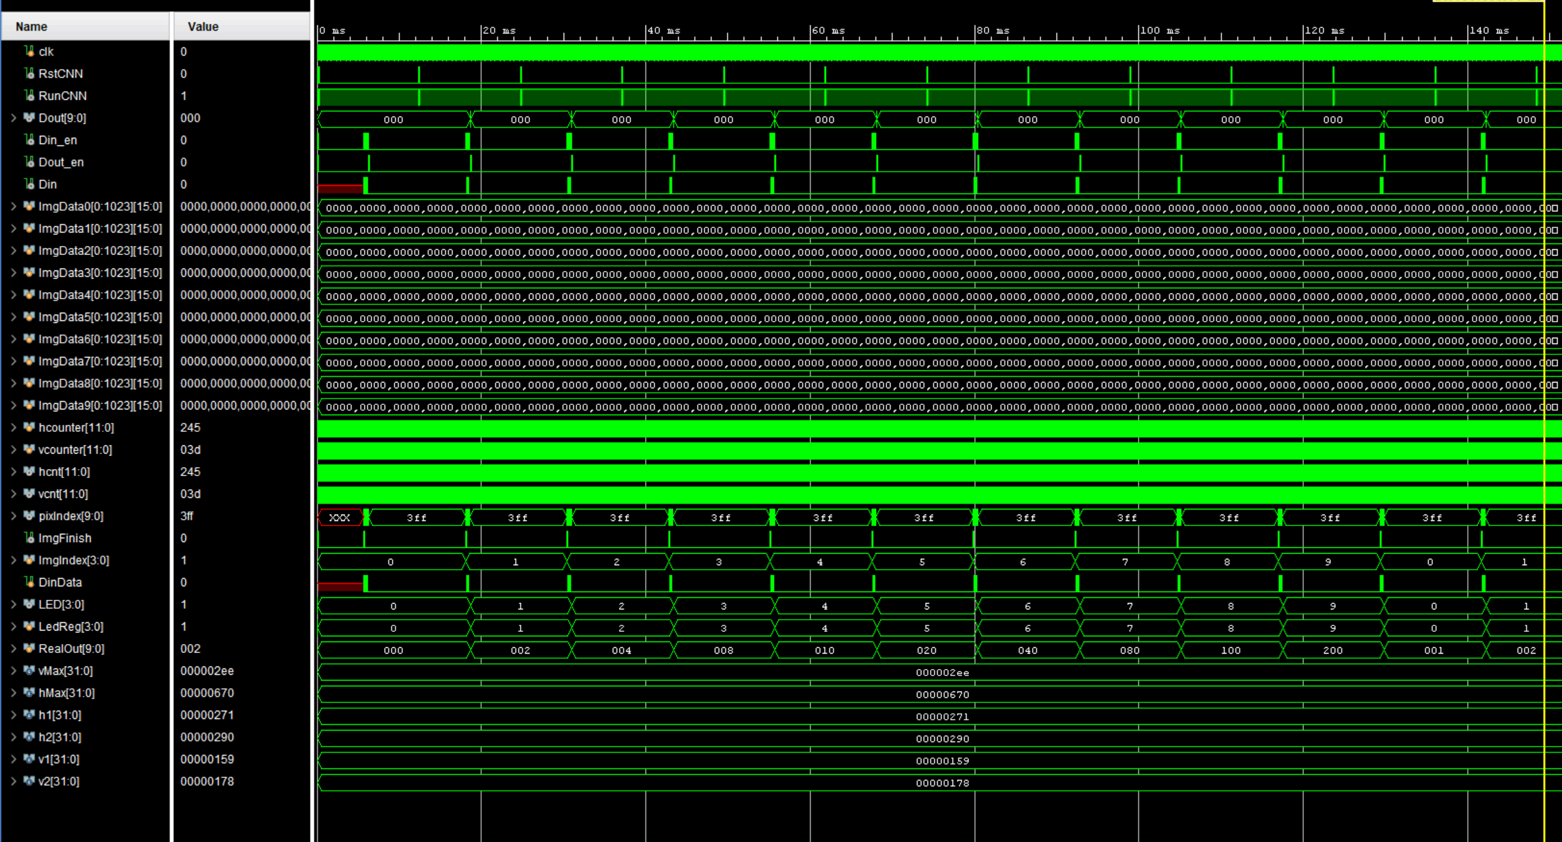
CNN Simulation Results
0-9 Digitals: waveform

Slide 42
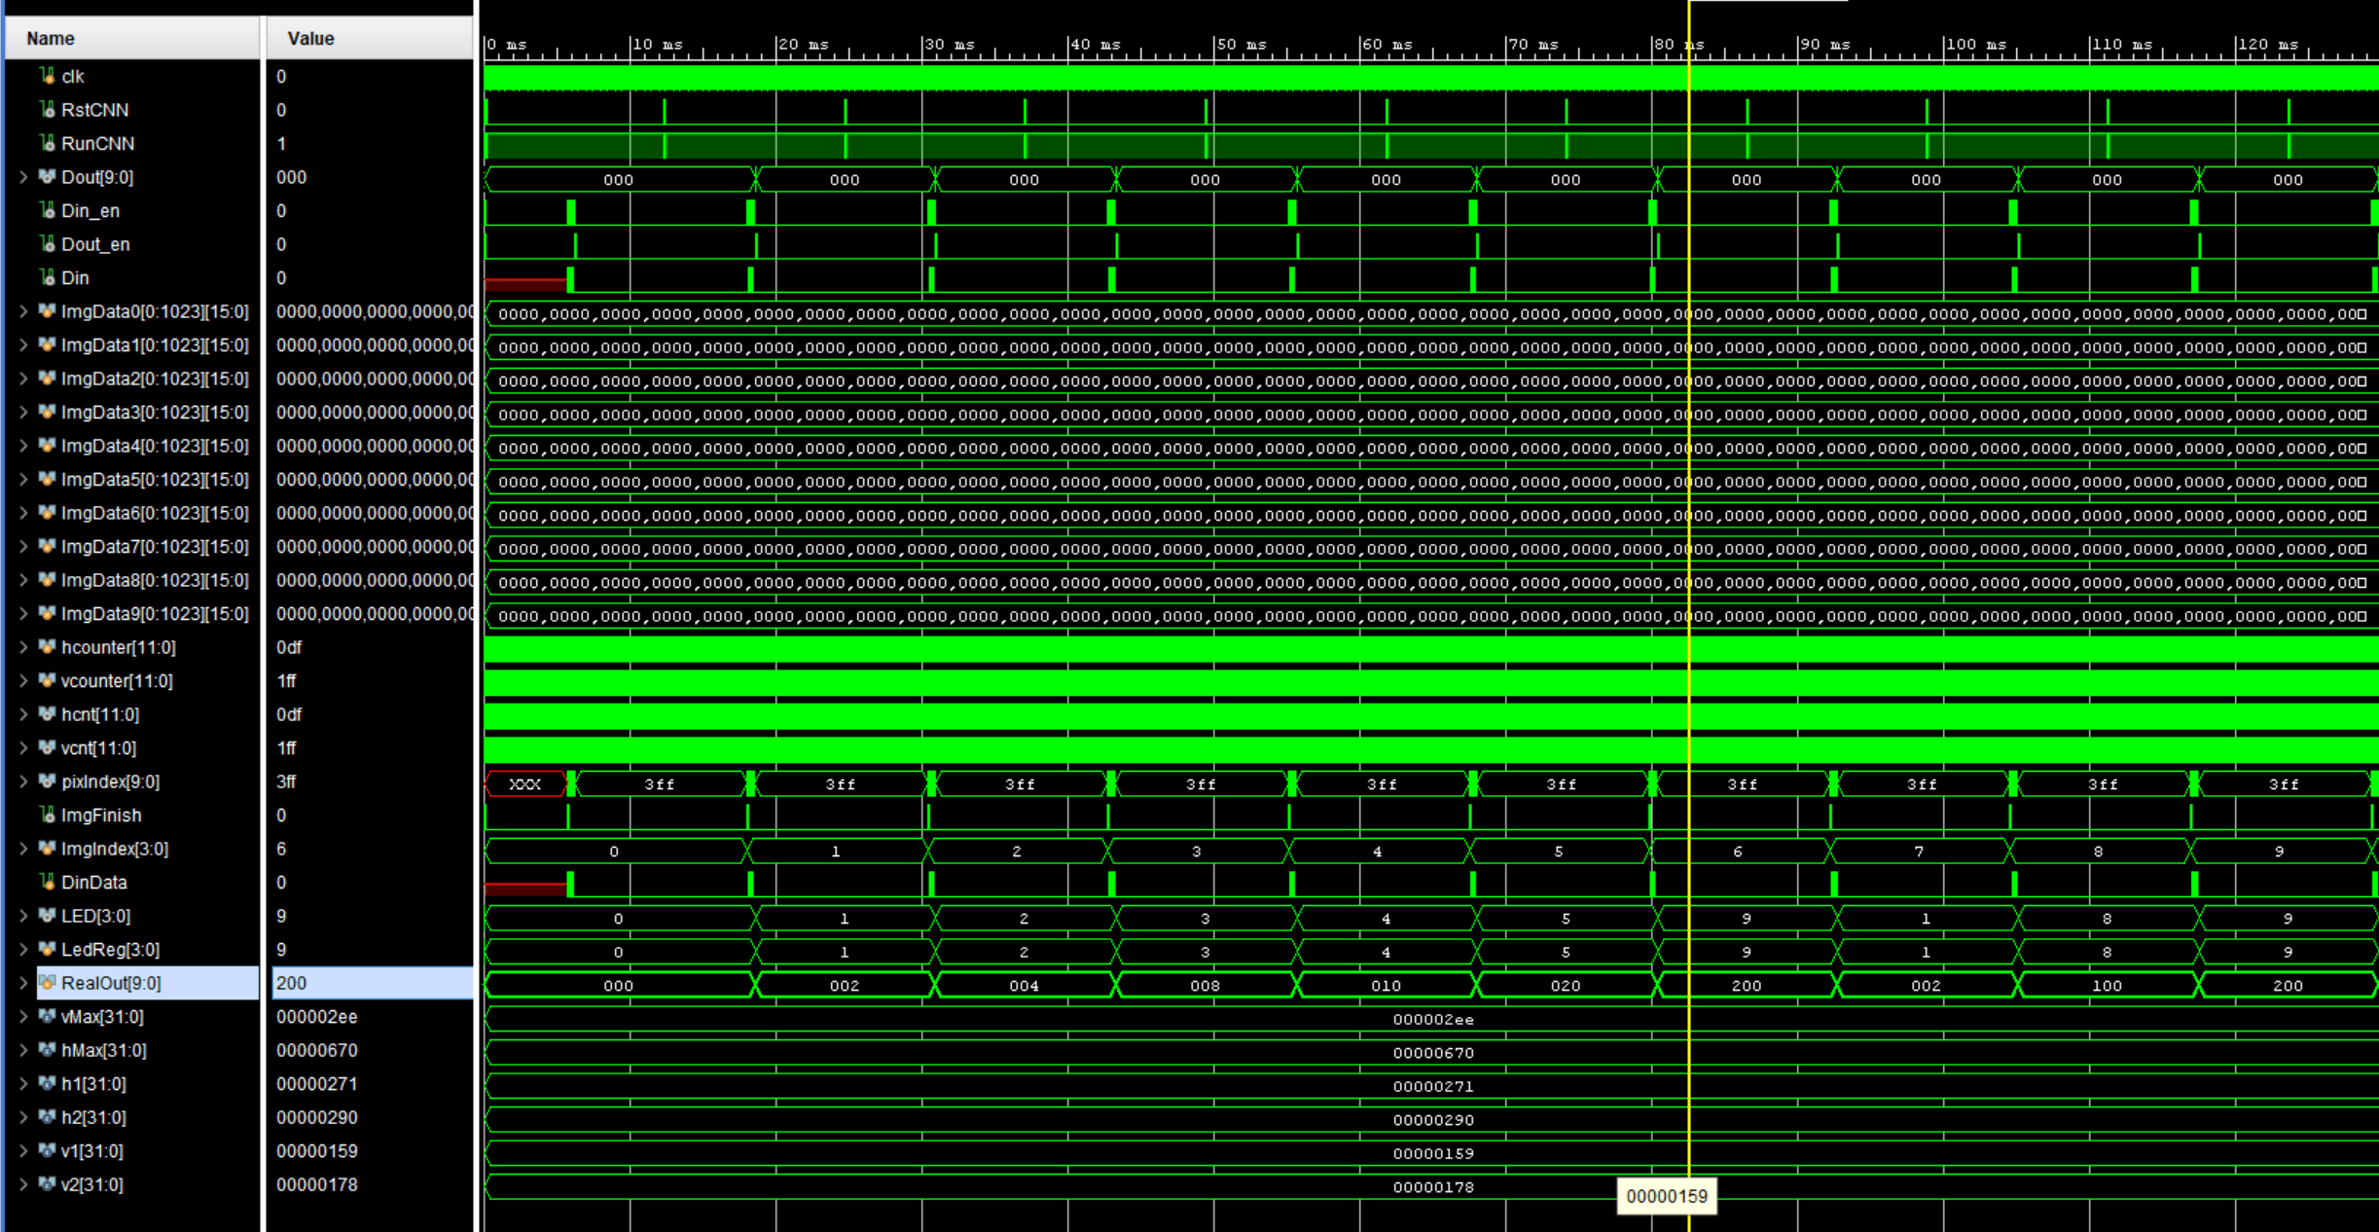
CNN Simulation Results
0-9 Digitals: waveform

Slide 43
Route Summary
Paper Reading & Preparation 11.15-11.21
Build Environment & Learning Operation 11.22-11.28
PULP NN Implementation & Compiling 11.29-12.12
LeNet & FPGA Implantation 12.13-12.19
HDMI & Camera Connection 12.20-12.26
Waveform & Simulation 12.27-1.5

Slide 44

Thank You!
Q&A

